Slide 1
MongoDB for Time Series Data
#MongoDBDays
Mark Helmstetter
@helmstetter
Senior Solutions Architect, MongoDB

Slide 2
What is Time Series Data?

Slide 3
Time Series
A time series is a sequence of data points, measured typically at successive points in time spaced at uniform time intervals.
Wikipedia
time
0
2
4
6
8
10
12
Notes:
Data produced at regular intervals, ordered in time. Want to capture this data and build an application.

Slide 4
Time Series Data is Everywhere
Financial markets pricing (stock ticks)
Sensors (temperature, pressure, proximity)
Industrial fleets (location, velocity, operational)
Social networks (status updates)
Mobile devices (calls, texts)
Systems (server logs, application logs)

Slide 5
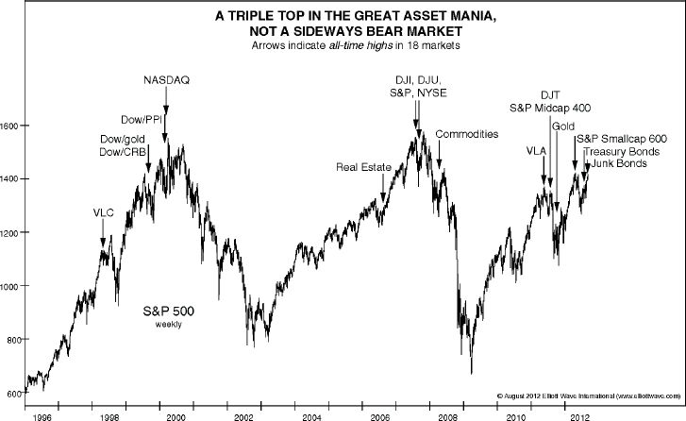
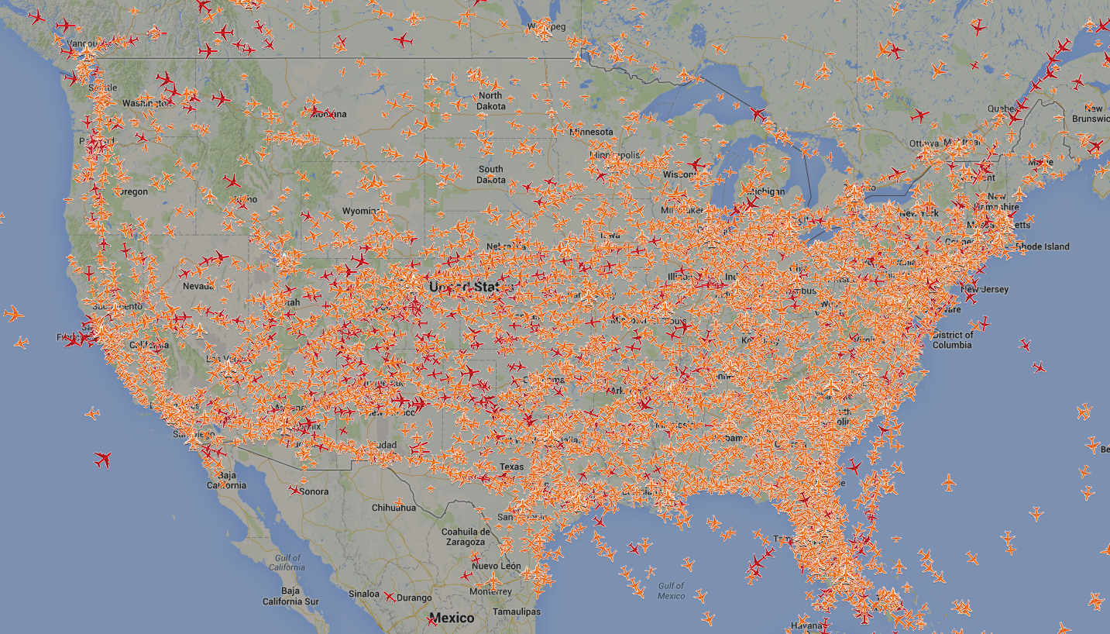
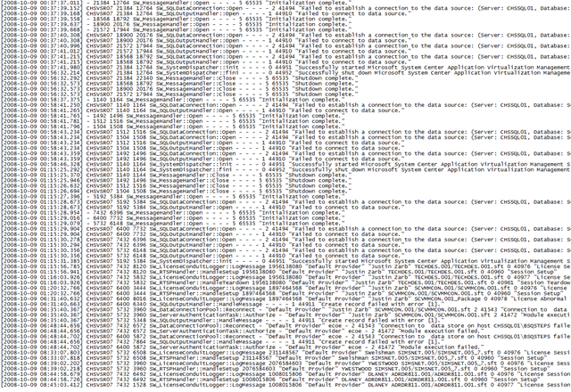

Time Series Data is Everywhere

Slide 6
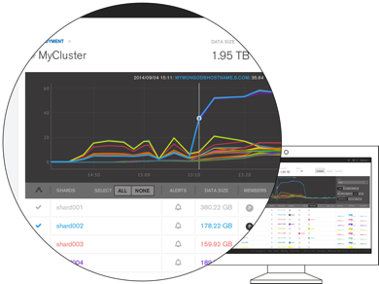
Example: MMS Monitoring
Tool for managing & monitoring MongoDB systems
100+ system metrics visualized and alerted
35,000+ MongoDB systems submitting data every 60 seconds
90% updates, 10% reads
~30,000 updates/second
~3.2B operations/day
8 x86-64 servers
Notes:
Need to clarify the new flavors of MMS?

Slide 7
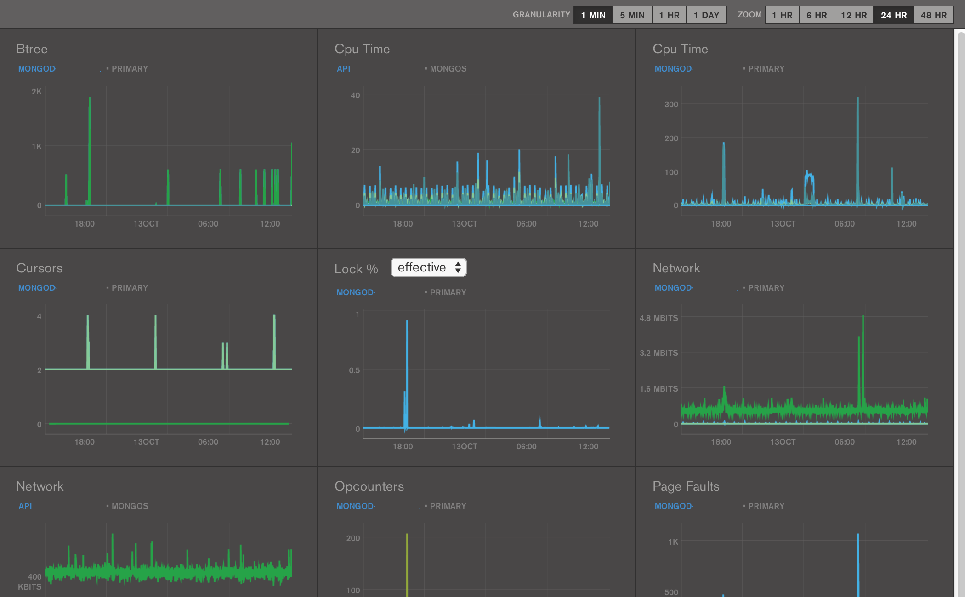
MMS Monitoring Dashboard

Slide 8
Time Series Data at a Higher Level
Widely applicable data model
Applies to several different "data use cases"
Various schema and modeling options
Application requirements drive schema design

Slide 9
Time Series Data Considerations
Arrival rate & ingest performance
Resolution of raw events
Resolution needed to support
Applications
Analysis
Reporting
Data retention policies

Slide 10

Data Retention
How long is data required?
Strategies for purging data
TTL Collections
Batch remove({query})
Drop collection
Performance
Can effectively double write load
Fragmentation and Record Reuse
Index updates
Notes:
A special index type supports the implementation of TTL collections. TTL relies on a background thread in mongod that reads the date-typed values in the index and removes expired documents from the collection.

Slide 11
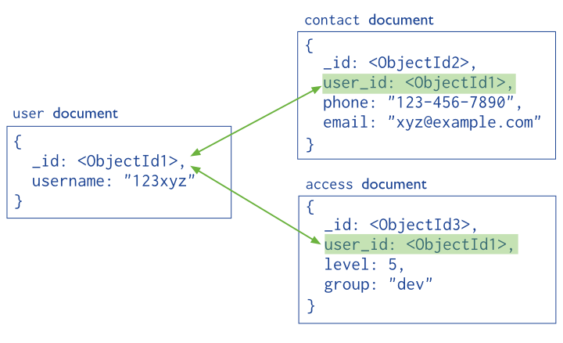
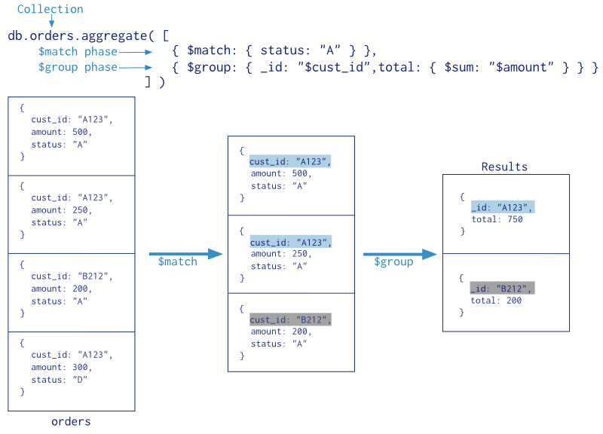
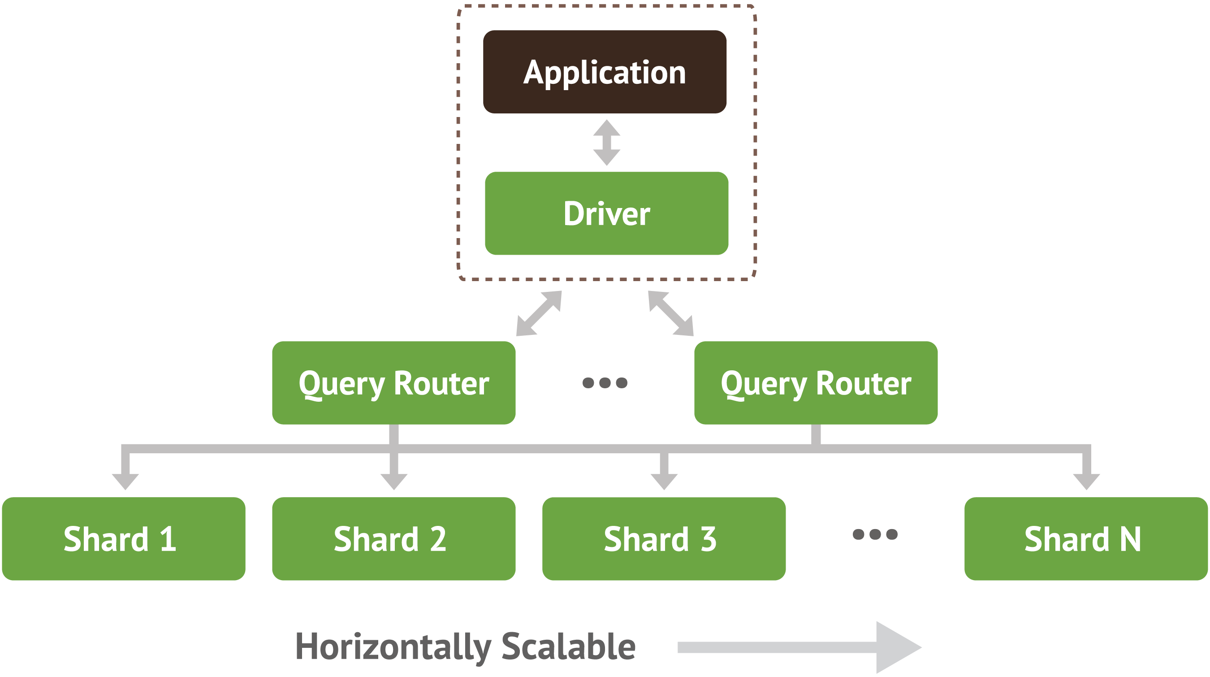
Application Requirements
Schema Design
Event Resolution
Analysis
Dashboards
Analytics
Reporting
Data Retention Policies
Event and Query Volumes
Aggregation Queries
Cluster Architecture

Slide 12
Our Mission Today

Slide 13
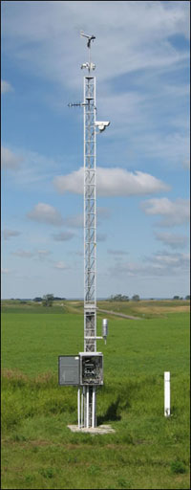
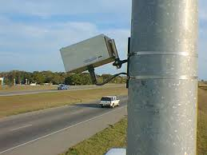
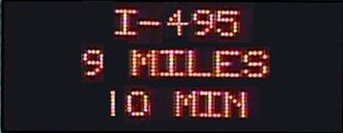
Notes:
Wind speed and direction sensor
Antenna for communications
Traffic speed and traffic count sensor
Pan-tilt-zoom color camera
Precipitation and visibility sensor
Air temperature and Relative Humidity sensor
Road surface temperature sensor and sub surface temperature sensor below pavement

Slide 14
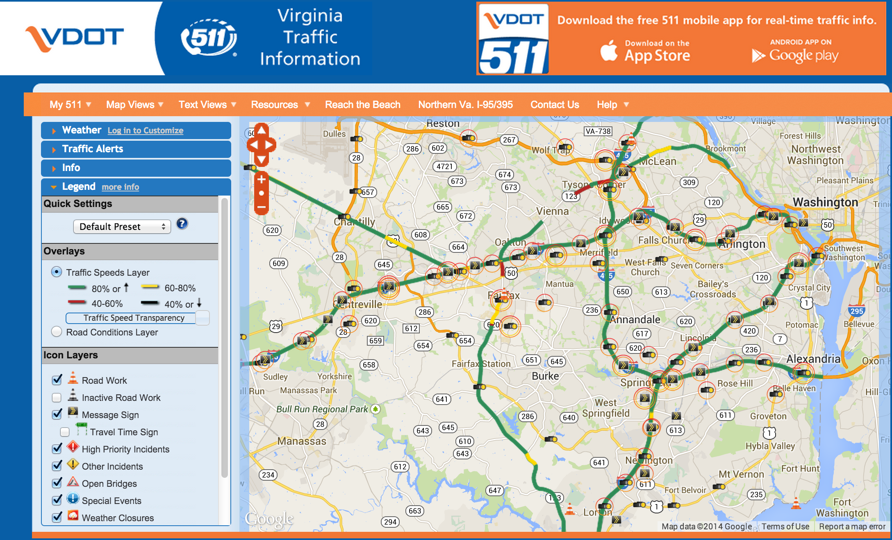
Notes:
511ny.org
Many states have 511 systems, data provided by dialing 511 and/or via webapp

Slide 15
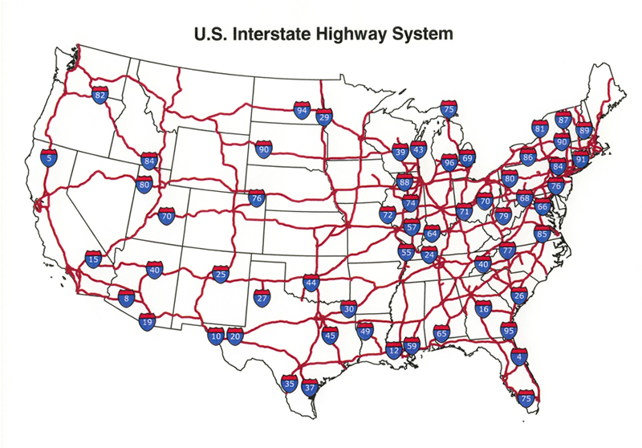
Develop Nationwide traffic monitoring system

Slide 16
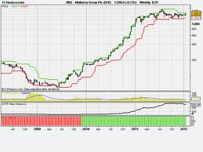
What we want from our data
Charting and Trending

Slide 17
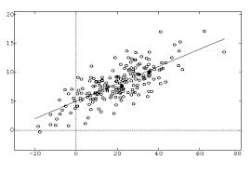
What we want from our data
Historical & Predictive Analysis

Slide 18
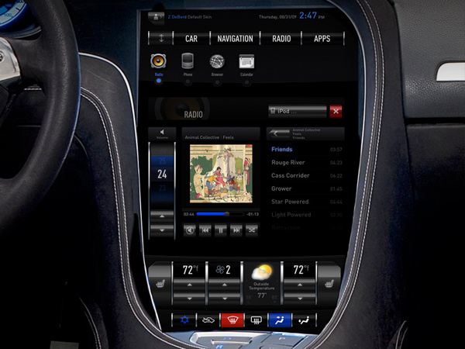
What we want from our data
Real Time Traffic Dashboard

Slide 19
Traffic sensors to monitor interstate conditions
16,000 sensors
Measure
Speed
Travel time
Weather, pavement, and traffic conditions
Minute level resolution (average)
Support desktop, mobile, and car navigation systems
Notes:
Assumptions/requirements for what we're going to spec out for this imaginary time series application

Slide 20
Other requirements
Need to keep 3 year history
Three data centers
VA, Chicago, LA
Need to support 5M simultaneous users
Peak volume (rush hour)
Every minute, each request the 10 minute average speed for 50 sensors
Notes:
Should I axe the 3 data centers bullet since we don't go into replication?

Slide 21
Master Agenda
Successfully deploy a MongoDB application at scale
Use case: traffic data
Presentation Components
Schema Design
Aggregation
Cluster Architecture

Slide 22
Schema Design Considerations

Slide 23
Schema Design Goals
Store raw event data
Support analytical queries
Find best compromise of:
Memory utilization
Write performance
Read/analytical query performance
Accomplish with realistic amount of hardware

Slide 24
Designing For Reading, Writing, …
Document per event
Document per minute (average)
Document per minute (second)
Document per hour

Slide 25
Document Per Event
{
segId: "I495_mile23",
date: ISODate("2013-10-16T22:07:38.000-0500"),
speed: 63
}
Relational-centric approach
Insert-driven workload
Aggregations computed at application-level

Slide 26
Document Per Minute (Average)
{
segId: "I495_mile23",
date: ISODate("2013-10-16T22:07:00.000-0500"),
speed_count: 18,
speed_sum: 1134,
}
Pre-aggregate to compute average per minute more easily
Update-driven workload
Resolution at the minute-level
Notes:
Use findAndModify with the $inc operator
63 mph average

Slide 27
Document Per Minute (By Second)
{
segId: "I495_mile23",
date: ISODate("2013-10-16T22:07:00.000-0500"),
speed: { 0: 63, 1: 58, …, 58: 66, 59: 64 }
}
Store per-second data at the minute level
Update-driven workload
Pre-allocate structure to avoid document moves

Slide 28
Document Per Hour (By Second)
{
segId: "I495_mile23",
date: ISODate("2013-10-16T22:00:00.000-0500"),
speed: { 0: 63, 1: 58, …, 3598: 45, 3599: 55 }
}
Store per-second data at the hourly level
Update-driven workload
Pre-allocate structure to avoid document moves
Updating last second requires 3599 steps

Slide 29
Document Per Hour (By Second)
{
segId: "I495_mile23",
date: ISODate("2013-10-16T22:00:00.000-0500"),
speed: {
0: {0: 47, …, 59: 45},
….
59: {0: 65, …, 59: 66} }
}
Store per-second data at the hourly level with nesting
Update-driven workload
Pre-allocate structure to avoid document moves
Updating last second requires 59+59 steps

Slide 30
Characterizing Write Differences
Example: data generated every second
For 1 minute:
Transition from insert driven to update driven
Individual writes are smaller
Performance and concurrency benefits
Document Per Event
60 writes
Document Per Minute
1 write, 59 updates
Notes:
*** clarify 2nd to last bullet

Slide 31
Characterizing Read Differences
Example: data generated every second
Reading data for a single hour requires:
Read performance is greatly improved
Optimal with tuned block sizes and read ahead
Fewer disk seeks
Document Per Event
3600 reads
Document Per Minute
60 reads

Slide 32
Characterizing Memory Differences
_id index for 1 billion events:
_id index plus segId and date index:
Memory requirements significantly reduced
Fewer shards
Lower capacity servers
Document Per Event
~32 GB
Document Per Minute
~.5 GB
Document Per Event
~100 GB
Document Per Minute
~2 GB
Notes:
How did we get these numbers…db.collection.stats() totalIndexSize, indexSizes []

Slide 33
Traffic Monitoring System Schema

Slide 34
Quick Analysis
Writes
16,000 sensors, 1 insert/update per minute
16,000 / 60 = 267 inserts/updates per second
Reads
5M simultaneous users
Each requests 10 minute average for 50 sensors every minute
Notes:
Point out 1 doc per minute granularity, not per second
5M users performing 10 minute average

Slide 35
Tailor your schema to your application workload

Slide 36
Reads: Impact of Alternative Schemas
Query: Find the average speed over the last
ten minutes
10 minute average query
Schema | 1 sensor | 50 sensors
1 doc per event | 10 | 500
1 doc per 10 min | 1.9 | 95
1 doc per hour | 1.3 | 65
10 minute average query with 5M users
Schema | ops/sec
1 doc per event | 42M
1 doc per 10 min | 8M
1 doc per hour | 5.4M
Notes:
Need to practice this

Slide 37
Writes: Impact of alternative schemas
1 Sensor - 1 Hour
Schema | Inserts | Updates
doc/event | 60 | 0
doc/10 min | 6 | 54
doc/hour | 1 | 59
16000 Sensors – 1 Day
Schema | Inserts | Updates
doc/event | 23M | 0
doc/10 min | 2.3M | 21M
doc/hour | .38M | 22.7M

Slide 38
Sample Document Structure
{ _id: ObjectId("5382ccdd58db8b81730344e2"),
segId: "900006",
date: ISODate("2014-03-12T17:00:00Z"),
data: [
{ speed: NaN, time: NaN },
{ speed: NaN, time: NaN },
{ speed: NaN, time: NaN },
...
],
conditions: {
status: "Snow / Ice Conditions",
pavement: "Icy Spots",
weather: "Light Snow"
}
}
Compound, unique
Index identifies the
Individual document
Notes:
Compound unique index on segId & date
update field used to identify new documents for aggregation

Slide 39
Memory: Impact of alternative schemas
1 Sensor - 1 Hour
Schema | # of Documents | Index Size (bytes)
doc/event | 60 | 4200
doc/10 min | 6 | 420
doc/hour | 1 | 70
16000 Sensors – 1 Day
Schema | # of Documents | Index Size
doc/event | 23M | 1.3 GB
doc/10 min | 2.3M | 131 MB
doc/hour | .38M | 1.4 MB
Notes:
Need to redo these index sizes based on different data types for segId?

Slide 40
Sample Document Structure
{ _id: "900006:14031217",
data: [
{ speed: NaN, time: NaN },
{ speed: NaN, time: NaN },
{ speed: NaN, time: NaN },
...
],
conditions: {
status: "Snow / Ice Conditions",
pavement: "Icy Spots",
weather: "Light Snow"
}
}
Saves an extra index

Slide 41
Sample Document Structure
{ _id: "900006:14031217",
data: [
{ speed: NaN, time: NaN },
{ speed: NaN, time: NaN },
{ speed: NaN, time: NaN },
...
],
conditions: {
status: "Snow / Ice Conditions",
pavement: "Icy Spots",
weather: "Light Snow"
}
}
Range queries:
/^900006:1403/
Regex must be
left-anchored &
case-sensitive

Slide 42
Sample Document Structure
{ _id: "900006:140312",
data: [
{ speed: NaN, time: NaN },
{ speed: NaN, time: NaN },
{ speed: NaN, time: NaN },
...
],
conditions: {
status: "Snow / Ice Conditions",
pavement: "Icy Spots",
weather: "Light Snow"
}
}
Pre-allocated,
60 element array of
per-minute data

Slide 43
Analysis with The Aggregation Framework

Slide 44
Pipelining operations
Piping command line operations
grep
|
sort
|
uniq

Slide 45
Pipelining operations
Piping aggregation operations
$match
|
$group
|
$sort
Stream of documents
Result documents

Slide 46
What is the average speed for a given road segment?
> db.linkData.aggregate(
{ $match: { "_id" : /^20484097:/ } },
{ $project: { "data.speed": 1, segId: 1 } } ,
{ $unwind: "$data"},
{ $group: { _id: "$segId", ave: { $avg: "$data.speed"} } }
);
{ "_id" : 20484097, "ave" : 47.067650676506766 }

Slide 47
What is the average speed for a given road segment?
> db.linkData.aggregate(
{ $match: { "_id" : /^20484097:/ } },
{ $project: { "data.speed": 1, segId: 1 } } ,
{ $unwind: "$data"},
{ $group: { _id: "$segId", ave: { $avg: "$data.speed"} } }
);
{ "_id" : 20484097, "ave" : 47.067650676506766 }
Select documents on the target segment

Slide 48
What is the average speed for a given road segment?
> db.linkData.aggregate(
{ $match: { "_id" : /^20484097:/ } },
{ $project: { "data.speed": 1, segId: 1 } } ,
{ $unwind: "$data"},
{ $group: { _id: "$segId", ave: { $avg: "$data.speed"} } }
);
{ "_id" : 20484097, "ave" : 47.067650676506766 }
Keep only the fields we really need

Slide 49
What is the average speed for a given road segment?
> db.linkData.aggregate(
{ $match: { "_id" : /^20484097:/ } },
{ $project: { "data.speed": 1, segId: 1 } } ,
{ $unwind: "$data"},
{ $group: { _id: "$segId", ave: { $avg: "$data.speed"} } }
);
{ "_id" : 20484097, "ave" : 47.067650676506766 }
Loop over the array of data points

Slide 50
What is the average speed for a given road segment?
> db.linkData.aggregate(
{ $match: { "_id" : /^20484097:/ } },
{ $project: { "data.speed": 1, segId: 1 } } ,
{ $unwind: "$data"},
{ $group: { _id: "$segId", ave: { $avg: "$data.speed"} } }
);
{ "_id" : 20484097, "ave" : 47.067650676506766 }
Use the handy $avg operator

Slide 51
More Sophisticated Pipelines: average speed with variance
{ "$project" : {
mean: "$meanSpd",
spdDiffSqrd : {
"$map" : {
"input": {
"$map" : {
"input" : "$speeds",
"as" : "samp",
"in" : { "$subtract" : [ "$$samp", "$meanSpd" ] }
}
},
as: "df", in: { $multiply: [ "$$df", "$$df" ] }
} } } },
{ $unwind: "$spdDiffSqrd" },
{ $group: { _id: mean: "$mean", variance: { $avg: "$spdDiffSqrd" } } }

Slide 52
How much IO is this?
All the queries are against the same data
Extremely low page fault rate: 1%?
10 minute average query
Schema | 1M users (ops/sec) | 1M users (page faults/sec)
1 doc per event | 8,333,333.33 | 83,333
1 doc per 10 min | 1,583,333.33 | 15833
1 doc per hour | 1,083,333.33 | 9722

Slide 53
High Volume Data Feed (HVDF)

Slide 54
High Volume Data Feed (HVDF)
Framework for time series data
Validate, store, aggregate, query, purge
Simple REST API
Batch ingest
Tasks
Indexing
Data retention

Slide 55
High Volume Data Feed (HVDF)
Customized via plugins
Time slicing into collections, purging
Storage granularity of raw events
_id generation
Interceptors
Open source
https://github.com/10gen-labs/hvdf

Slide 56
Summary
Tailor your schema to your application workload
Bucketing/aggregating events will
Improve write performance: inserts → updates
Improve analytics performance: fewer document reads
Reduce index size → reduce memory requirements
Aggregation framework for analytic queries

Slide 57

Questions?

